Slide 1
Plateforme expérimentale pour la dynamique ultra-rapide
Bilan de l’activité 2017
Bertrand Carré LIDYL

Slide 2

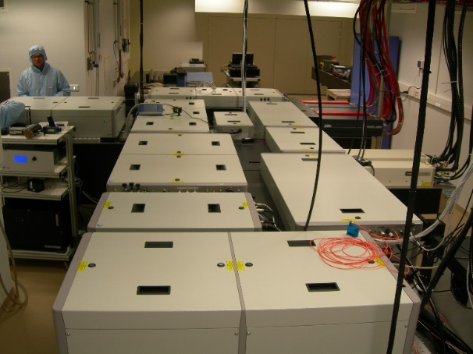
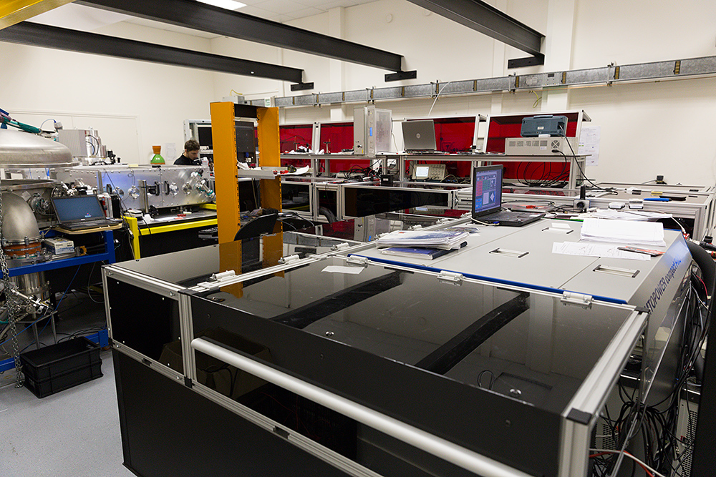






9 partners – 3 sites
Gas phase
Condensed phase
XUV Optics
Plasmas
LPMS

Slide 3
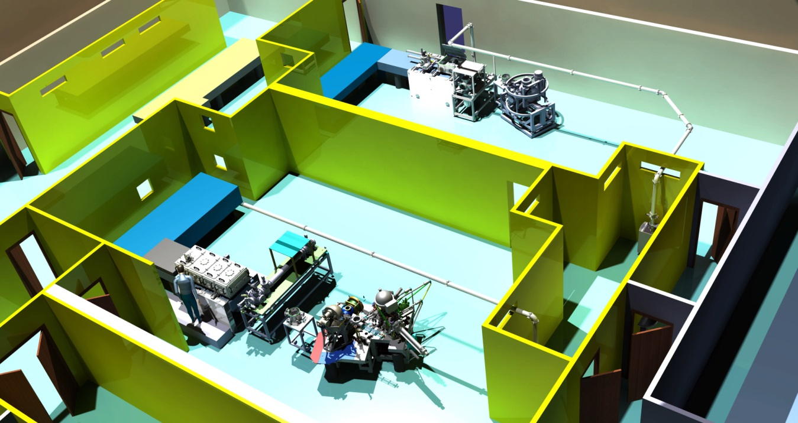
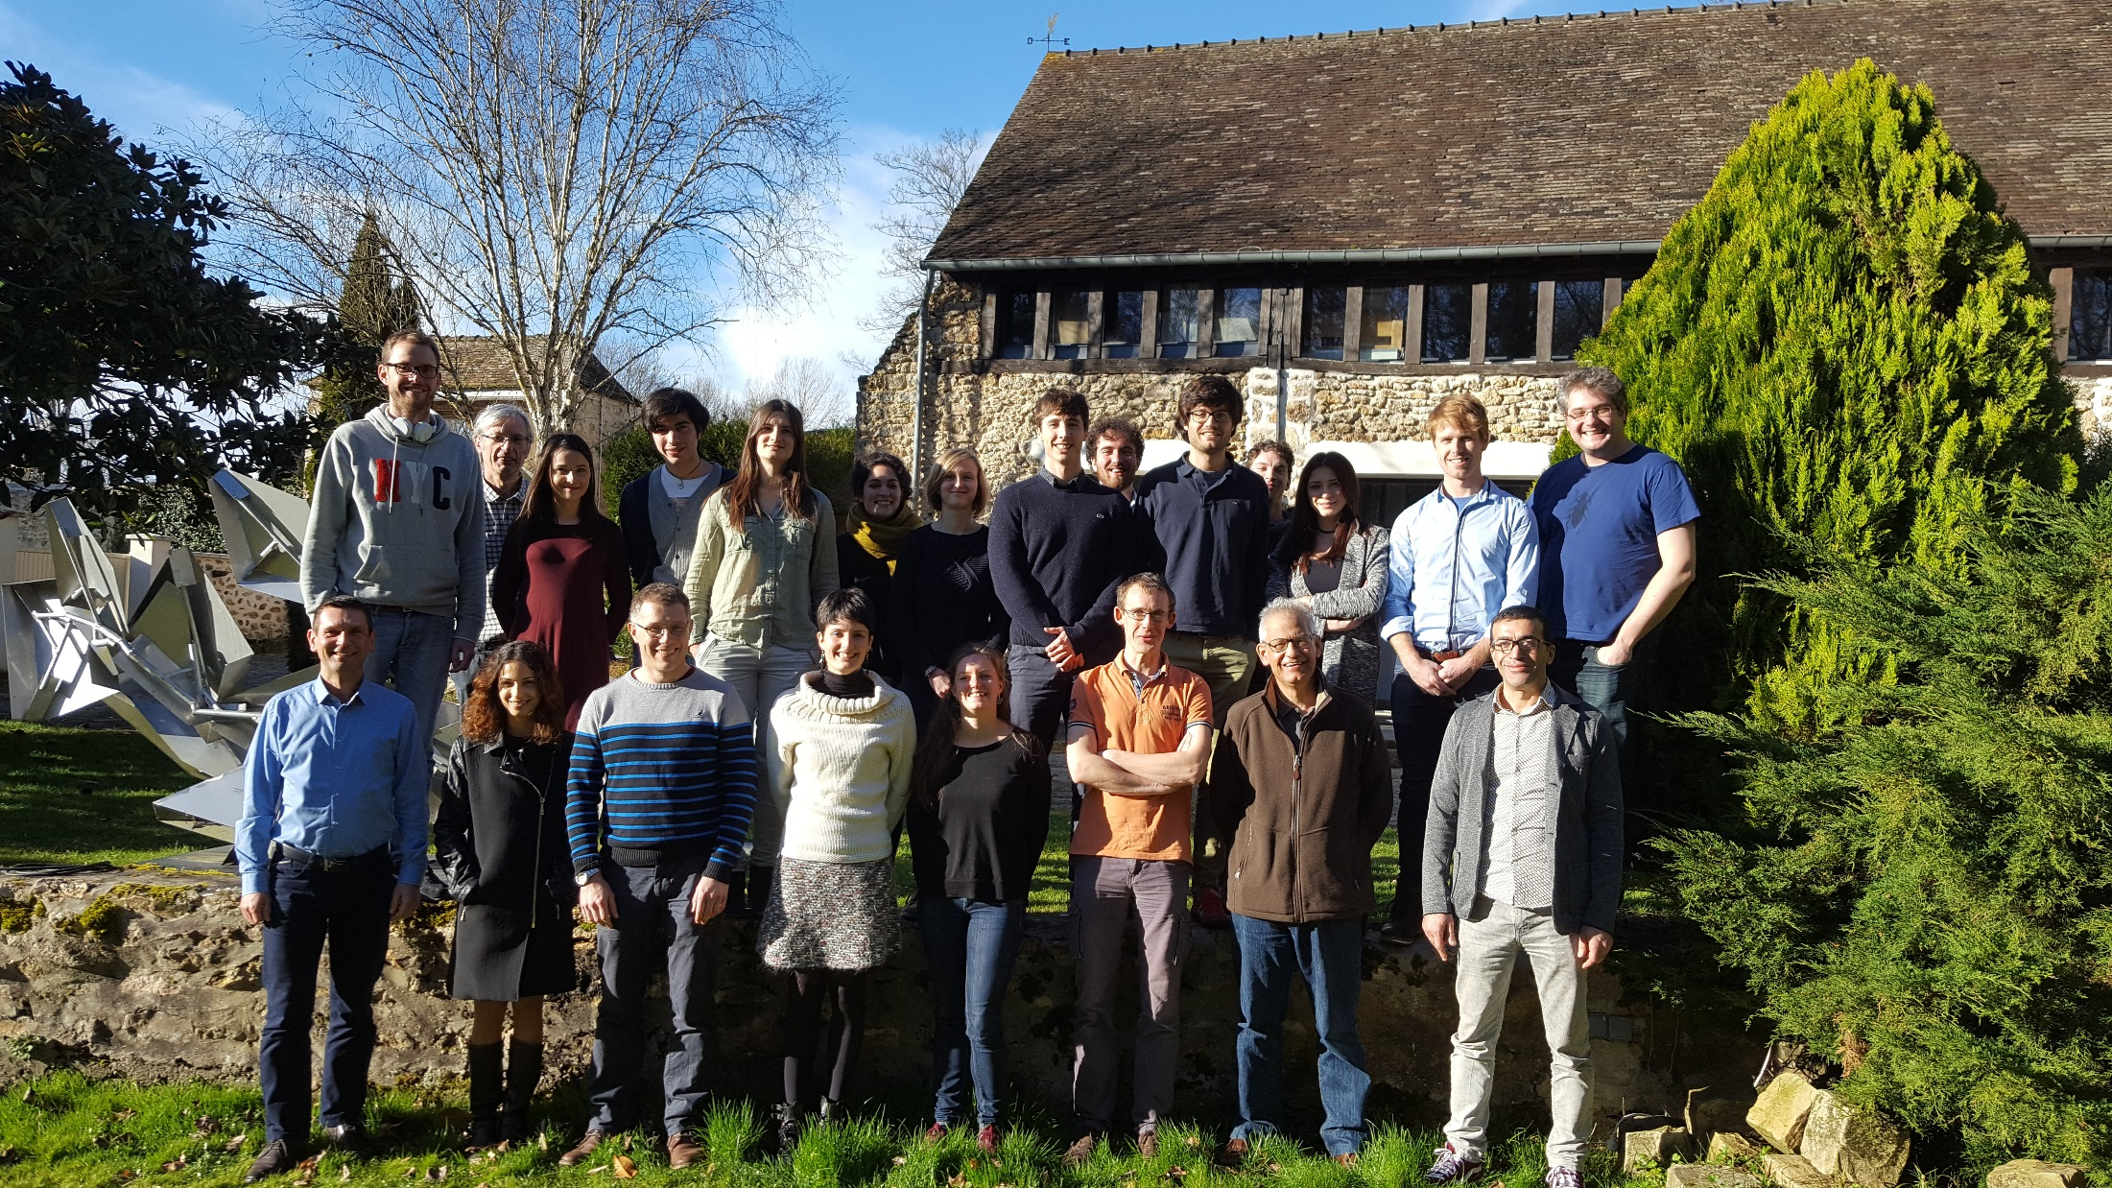
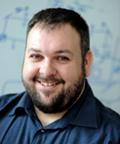
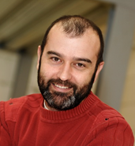
Lasers & SE1 – SE10 exp. halls
LASER
SE1
Antonin Borot
SE10
Jean-François
Hergott
Thierry Ruchon
Olivier
Tcherbakoff

Slide 4
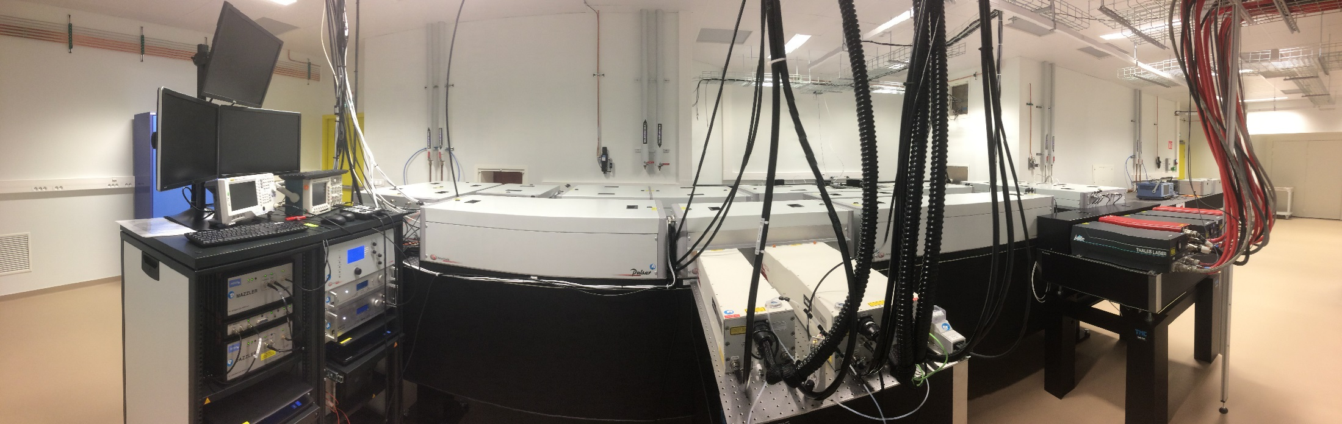
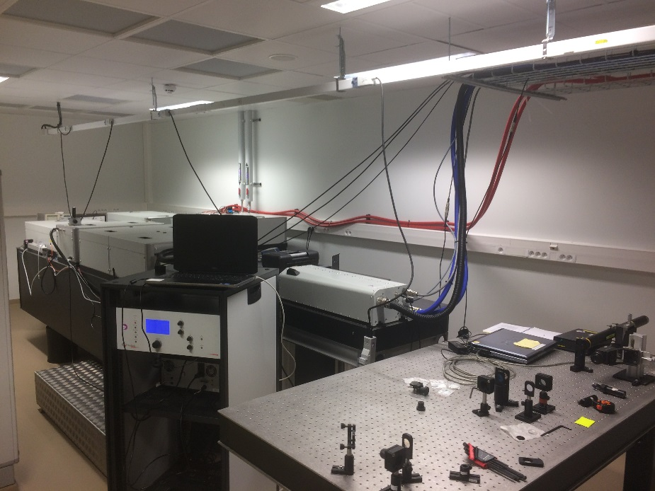

Lasers FAB1 & FAB10
A. Golinelli, O. Tcherbakoff, J.-F. Hergott, F. Lepetit, F. Réau, P. d’Oliveira
laser | λ | Average power | energy/pulse | pulse duration | shot-to-shot CEP stab. | rep rate | operating
FAB1 | 800 nm | 15 W | 15 mJ | 24 fs - 15 fs | <350 mrad | 1 kHz | Oct 2016
FAB10 | 800 nm | 20 W | 2 mJ | 23 fs – 15 fs | <260 mrad | 10 kHz | Jan 2017
FAB1 : postcompression 15-20 fs → 7 fs (2018)
Laser R&D : joint lab IMPULSE
CEA-Amplitude Technologies
CEP stabilization
Sub-20fs pulses
IR frontend & amplifier tunability

Slide 5
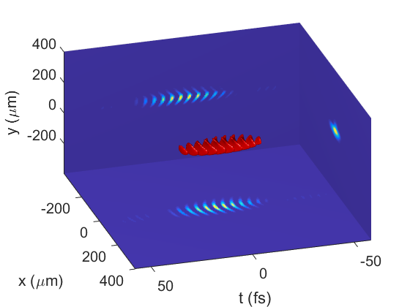

FAB1 : Mesure spatio-temporelle au foyer IR avec la technique INSIGHT
Antonin Borot
$${\left|E\left(x,y;t\right)\right|}^{2}$$
slight x, y astigmatism
to be corrected
Brevet en cours

Slide 6
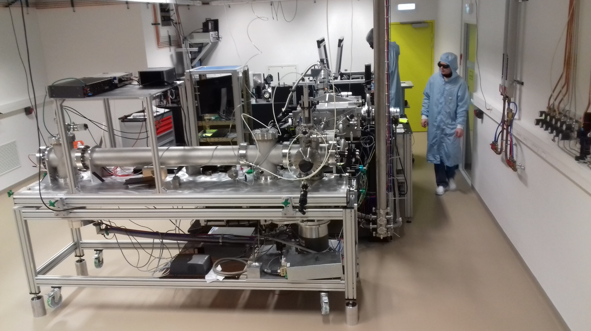
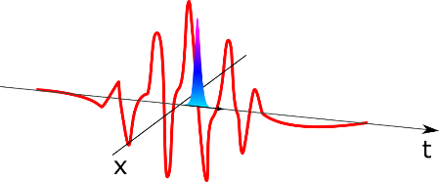
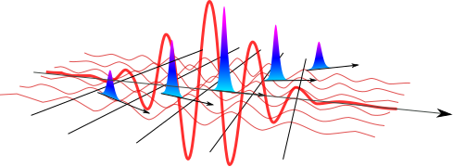
SE1 : IR-MIR/XUV beamline for flexible pump/probe studies in gas phase
A. Borot, L. Barreau, C. Alexandridi, M. Turconi, M. Billon, I. Vadillo-Torre, P. Salières
IR laser : 23 fs, 15 mJ, 1 kHz, CEP + mid-IR OPA (1,2-2 µm) :1 mJ + XUV source
Impulsion IR | Impulsion mid-IR | Impulsion XUV
Tunable 760-840nm (2018) Variable pol (lin-circ) Postcomp (2018) | Tunable 1200-2200 nm | Train / isolated atto pulse Variable pol (lin –circ) Atto lighthouse (2019)
MBS-TOF electron spectrometer
XUV diag - RABBIT spectroscopy

Slide 7
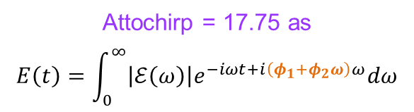
SE1: spectral amplitude & phase of electronic wavepackets by RABBIT spectroscopy
Photoionization of neon
Christina Alexandridi, Margherita Turconi, Lou Barreau, Antonin Borot , Pascal Salières
E[eV]
Attochirp = 17.75 as
$$E\left(t\right)=\int_{0}^{∞}{\left|ℰ\left(ω\right)\right|e^{−iωt+i\left(φ_{1}+φ_{2}ω\right)ω}dω}$$
IR
H37
H35
H33
Photoelectron energy [eV]
21.56
0
Harmonic comb
Notes:
To do so loipon we used a type of spectrally resolved electron interferometry that was developed by my colleges Vincent Gruson and Lou Barreau in Saclay. So what we do is to use a comb of (coherent) high harmonics to photoionize our system. Here with harmonic 39 we excite the sp2+ resonance and with harmonic 41 the sp3+ resonance and we create two resonant EWPs (which can be seen as a two electron EWP as was observed by Ott in 2014?). Then we add a weak IR field and we have perturbative 2_photon transitions that create replicas of our resonant EWPs that now lie at the same energy and thus they interfere. Now by varying the delay between XUV and IR we get a spectrogram like this and the interference of the two replica EWPs gives rise to these so called SBs whose signal oscillates with twice the frequency of the laser.
To detect these photoelectrons we used a 2 meter MBES.
We are interested mostly in the SBs signal that is given by this expression that oscillates with twice the laser frequency. The phase of this oscillation has two contributions one is this dfi who is the phase difference between two concequtive harmonics that we consider negligible in our case???? And then we have this hscatt which is intrinsic to the target atom and is our guy, is the phase that we want to access. To do so, we fourier transform this signal for every energy of the SB.
The two resonances apexoun 3.4eV but our photons have only 1.54 eV energy. So in order to tune the wavelegnth of the generating laser to hit both resonances simumtaneously we used a DAZZLER and thus we reached also the sp3+ and this is clear also from the spectrogram trace when looking to the nonresonant harmonics

Slide 8
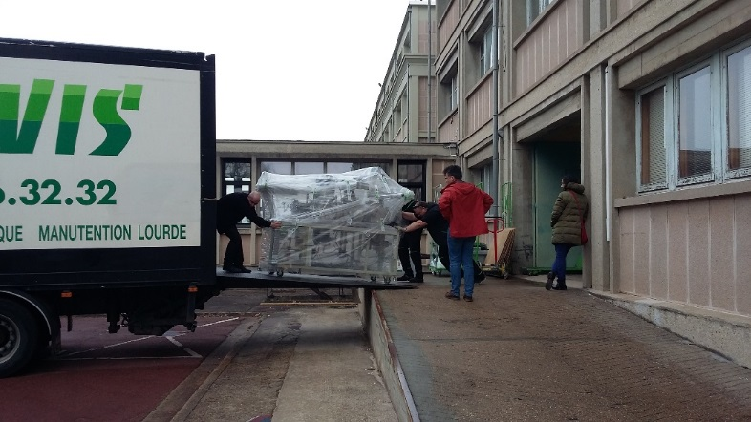
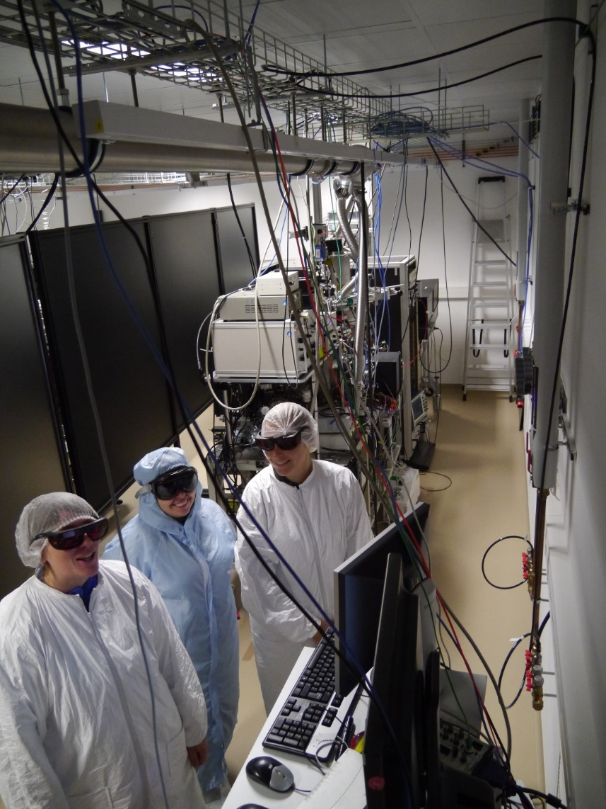
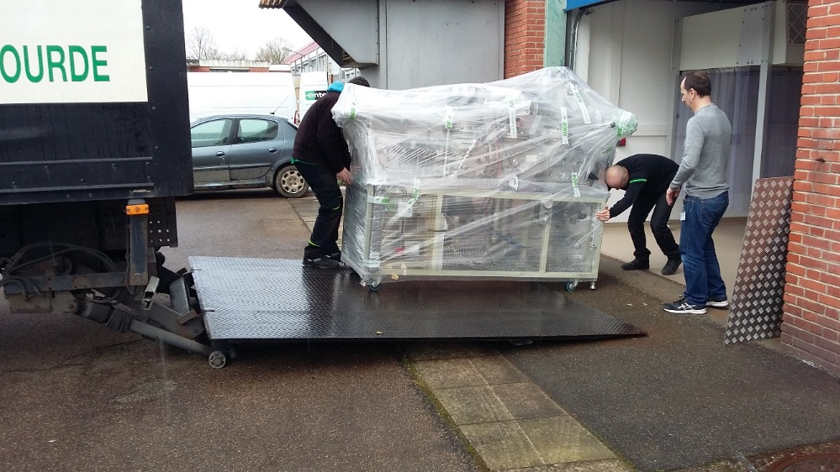
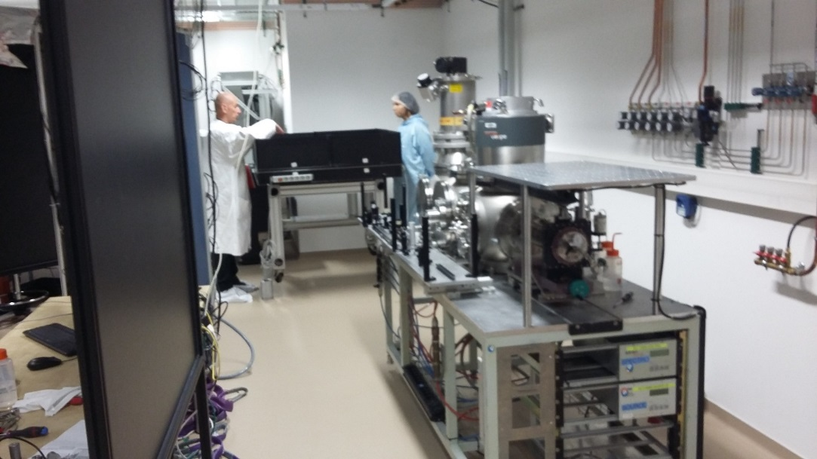
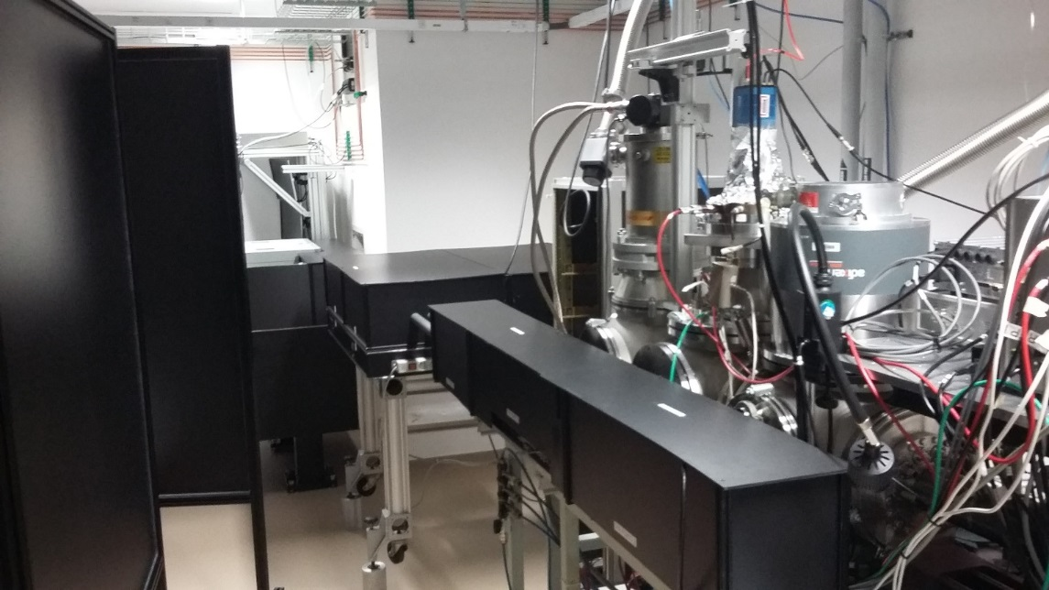
SE1 juin 2017 : installation Femto-Chromadyne
équipe DYR : Anja Röder, C. Pothier, B. Miranda da Cunha, L. Poisson
First LASERLAB4 program at ATTOLAB:
Studies of relaxation in radicals
Ingo Fischer’s group, Würzburg Univ.
communication by Anja R.

Slide 9
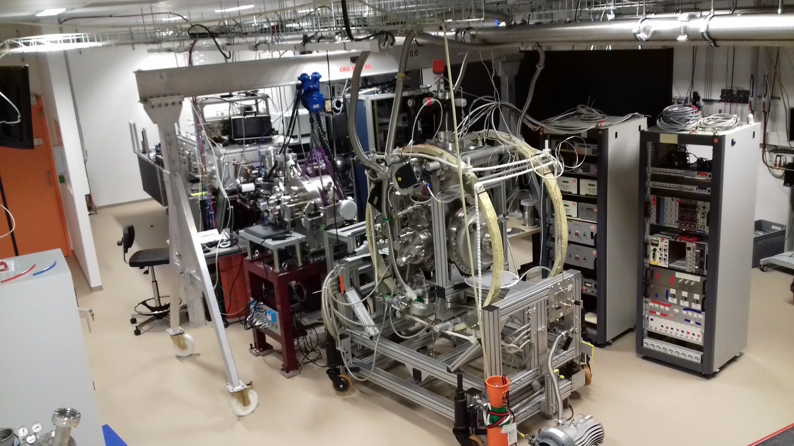

SE10 : high reprate IR/XUV beamline for multiscale studies gas and solid state
D. Bresteau, I. Vadillo-Torre, M. Billon, M. Bougeard, T. Ruchon
IR laser : 23 fs, 2 mJ, 10 kHz, CEP + XUV source
gas phase
e-ion COLTRIMS spectrometer
Multiscale spectral/temporal selection
XUV diag - RABBIT spectroscopy
Endstations for gas phase & solid state

Slide 10
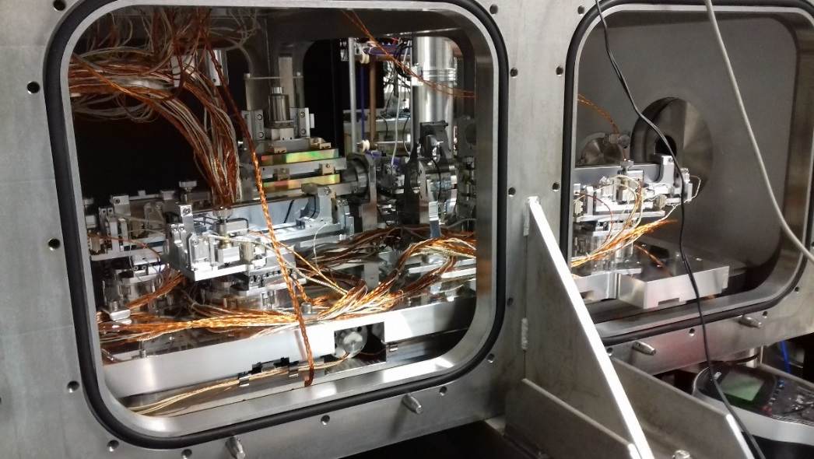
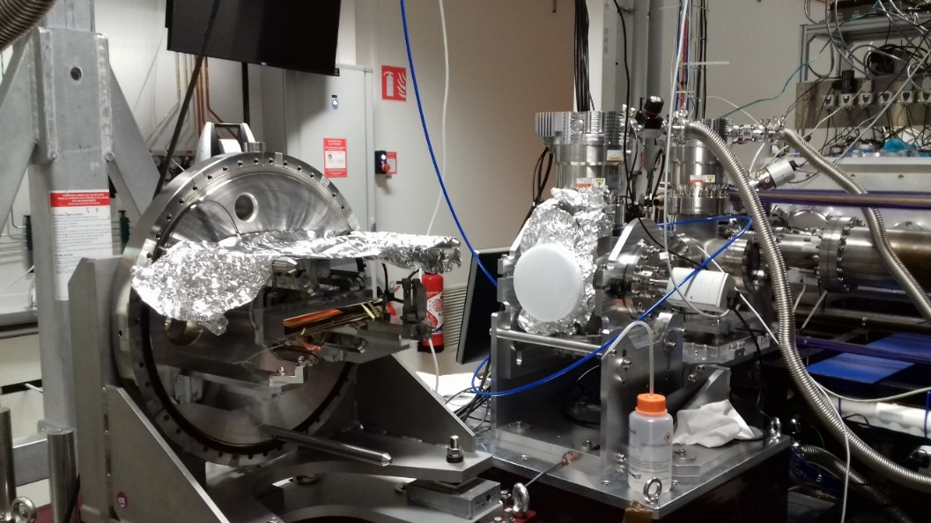
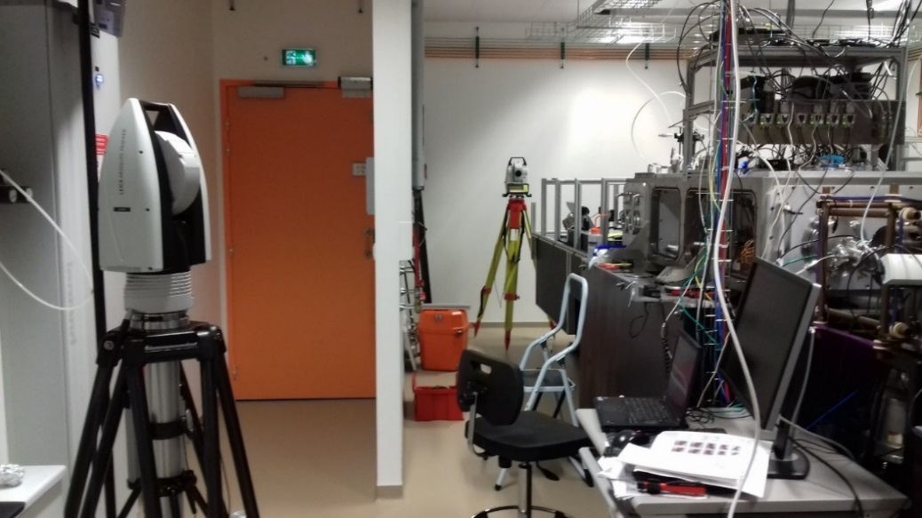
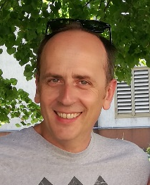
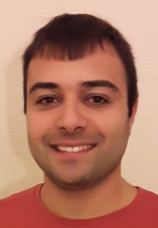

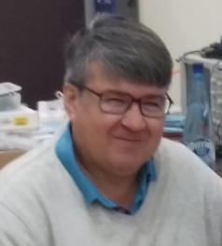

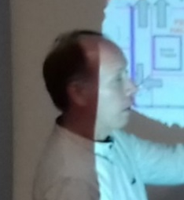
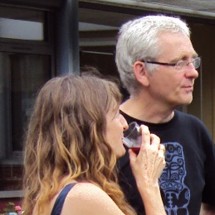
SE10 : IR/XUV beamline
XUV selection + IR/XUV delay line
Differential pumping + refocusing
OPT2X
Alignment
Carlo Spezzani, Julien Lenfant, Maël Dehlinger
David Dennetière, François Polack, Mourad Sebdaoui
Ismaël Vadillo-Torre, Marc Billon, G. Vigneron
S. Jubéra, M. Bougeard, David Bresteau, Romain Genéaux, T. Ruchon…
Tous les collègues Atto, SLIC et DIR
Tous les Partenaires

Slide 11
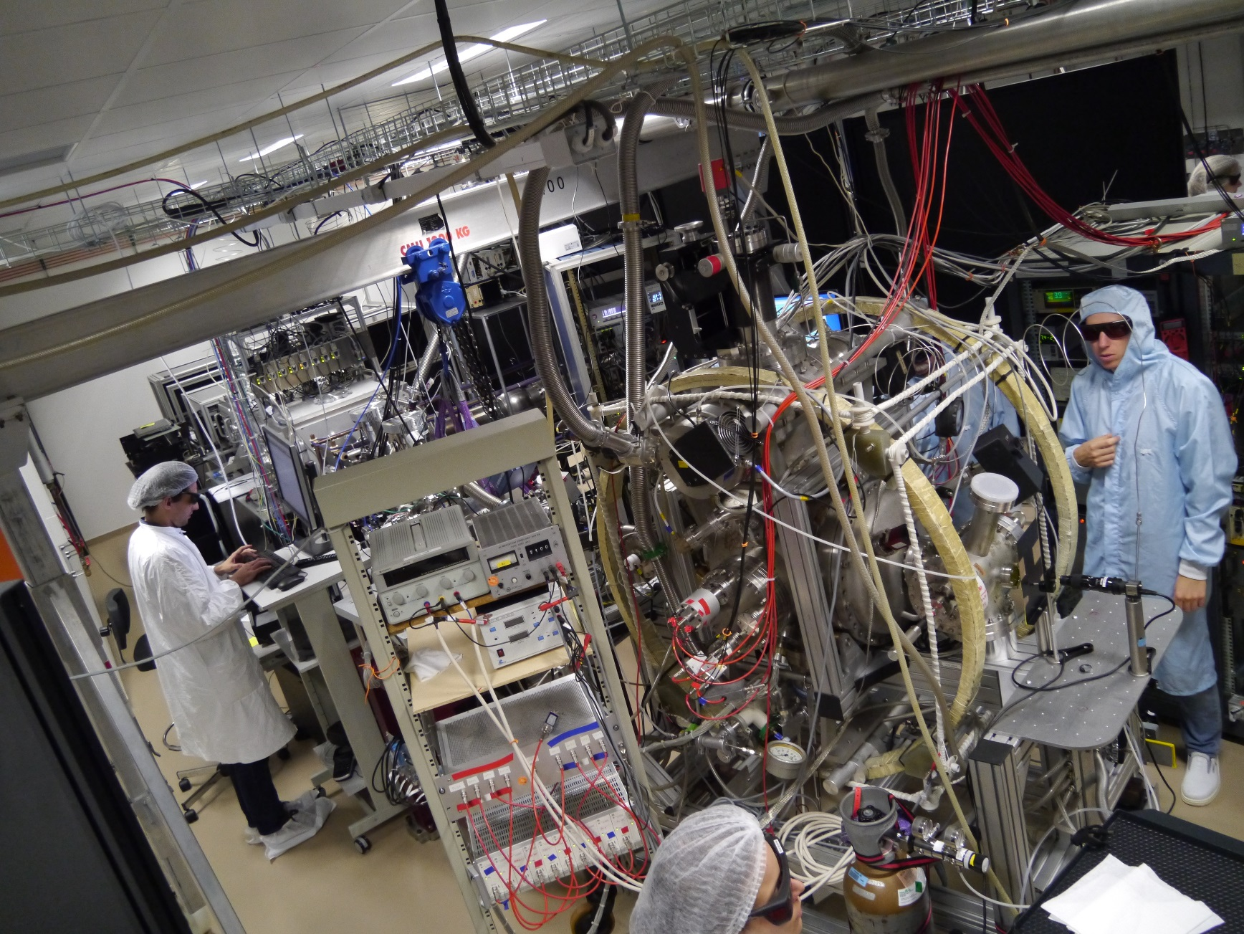
SE10 : operational oct 2017

Slide 12
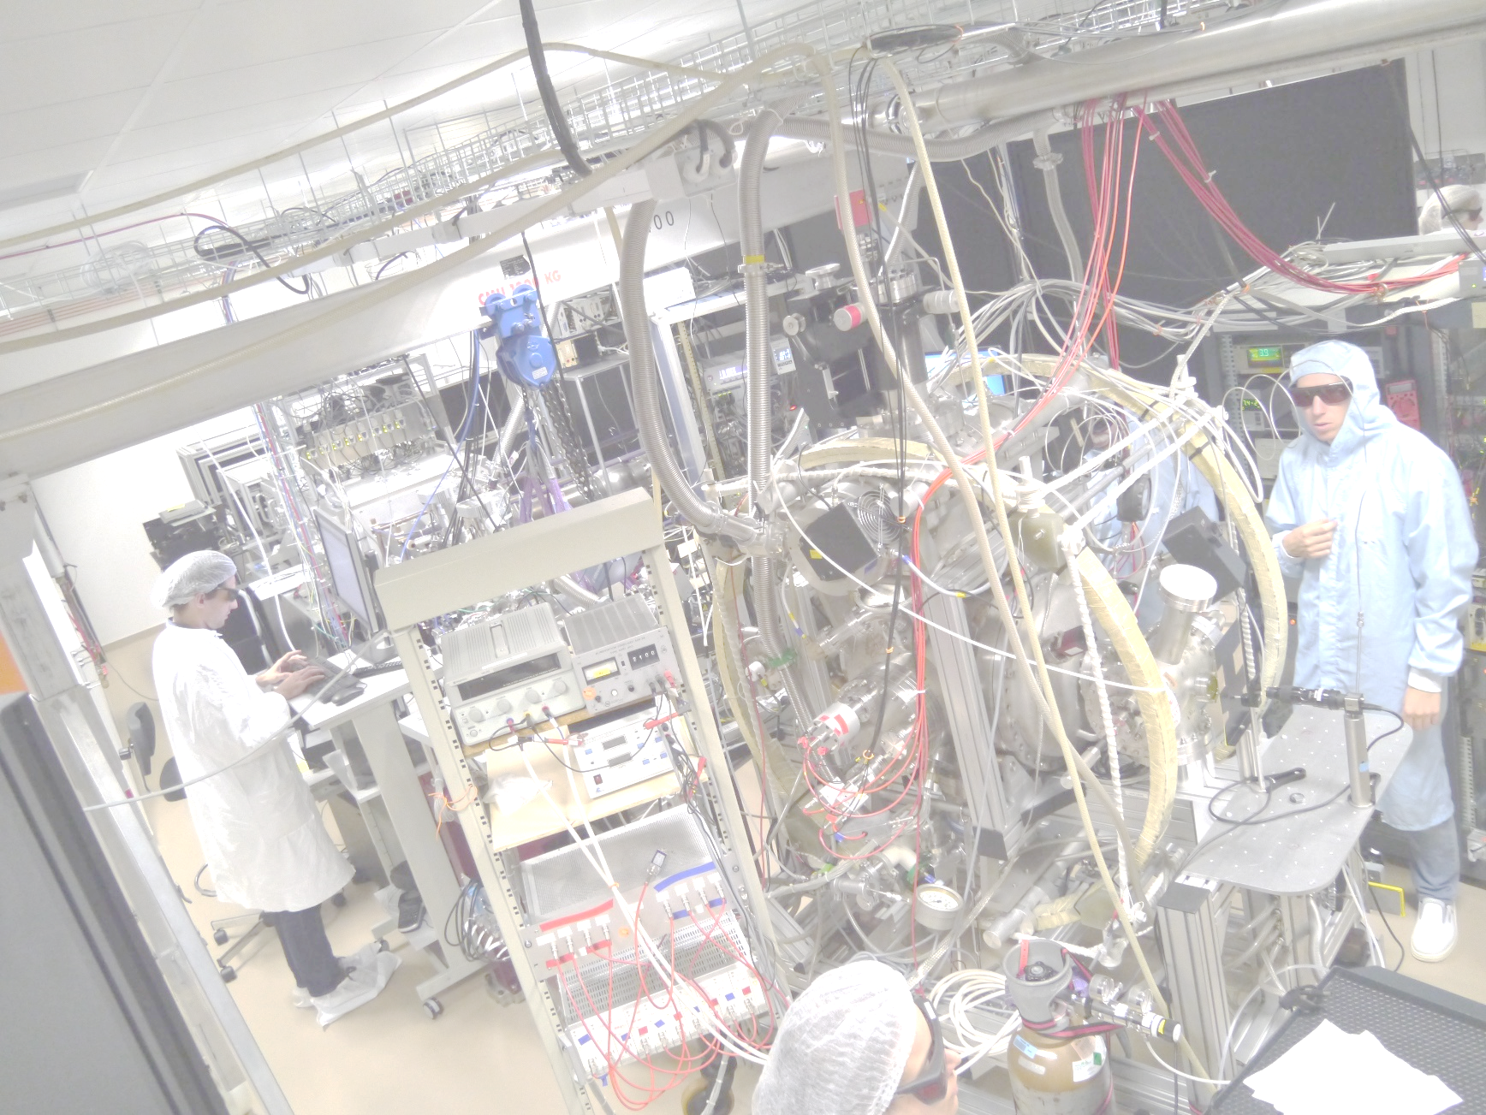
SE10 : First experiment in a COLTRIMS
Danielle Dowek, Jennifer Jospeh, Fabian Holzmeier, Jean-Christophe Houver
Measuring angularly resolved photoionization time delays in molecules
electron and ion momenta in coincidence in the molecular frame
Test case: photoionization of Ar:
bi-dimensionnal histogram of electron velocities

Slide 13
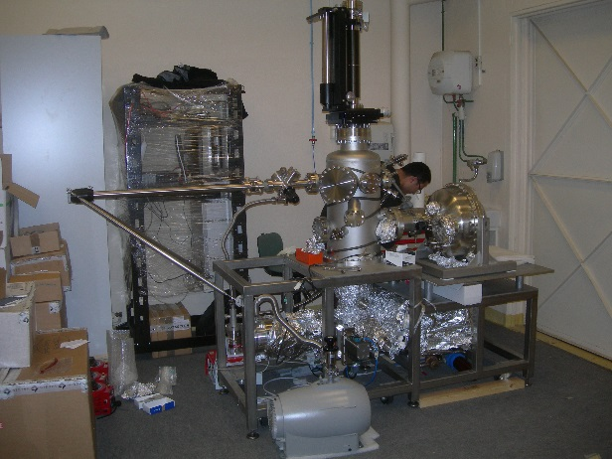
SE10 : Ultrafast dynamics in correlated materials
M. Marsi, E. Papalazarou, N. Moisan, V. Brouet (LPS); L. Perfetti, S. Guizard (LSI); J.P. Rueff, A. Taleb-Ibrahimi (SOLEIL)
2017: Préparation équipement FASTMAP pour time-resolved ARPES
03/10/2017: Transport dispositif de photoémission angulaire sur ATTOLAB-LIDYL
2017-T4_2018-T1 : matériaux corrélés: isolants de Mott
transition isolant-métal photoinduite dans composés de la famille Sr₂IrO₄

Slide 14
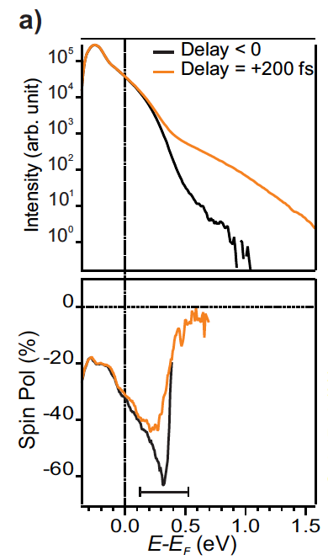
Signature of bulk half-metallicity in Fe₃O₄ (magnetite) from sub-ps electron spin dynamics
Ch. Richter, O. Heckmann, K. Hricovini, M. Battiato, J. Minar, C. Cacho
half-metal : metal and insulator at the same time, depending on the spin direction
metal
↓
semi-conductor
insulator
Exp: time-, spin-resolved photoemission dynamics
half-metal
↑
↓
Time-dependent spin polarization$P=\frac{D_{↑}\left(E_{F}\right)−D_{↓}\left(E_{F}\right)}{D_{↑}\left(E_{F}\right)+D_{↓}\left(E_{F}\right)}$
TOF-SPIN spectrometer
→ Experiment / theory agreement : unambiguously characterizes half- metallicity

Slide 15
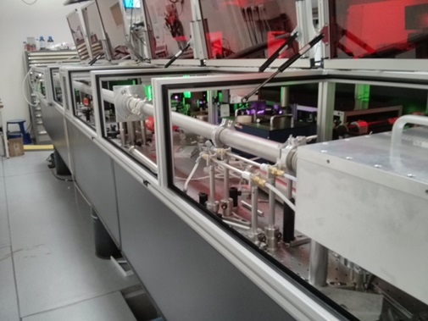
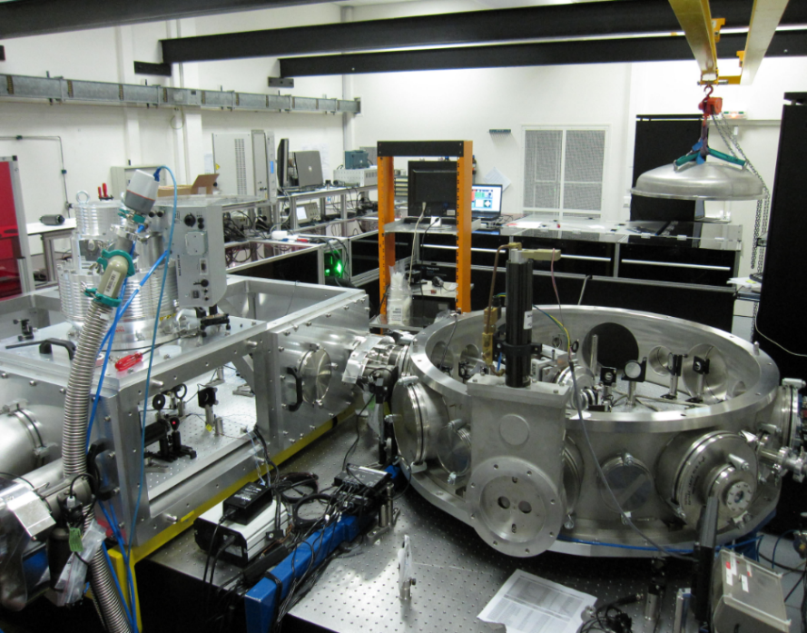
LOA : coherent e⁻ dynamics in plasmas
F. Boehle, S. Haessler, M. Lozano, J.-B. Margoto, B. Mercier, N. Naumova, J.-P. Rousseau, M. Thévenet, R. Lopez-Martens
laser | energy / Int on target | duration / reprate | contrast | CEP fluctuation | operating
Salle Noire 2.0 | 2.5 mJ / ~ 10¹⁹ W/cm² | 24fs - 3.5 fs / 1 kHz | >10¹⁰ (à 10 ps) | <350 mrad | 2016
Salle Noire 3.0 | 10 mJ / > 10¹⁹ W/cm² | 20fs – 3 fs / 1 kHz | >10¹¹ (à 10 ps) | <200 mrad | 2018
SalleNoire 2.0
Pulse postcompression
in hollow fiber
laser-plasma interaction chamber
Notes:
Remise en état du bâtiment P au LOA: financé par l’ENSTA, recette des travaux de rénovation fin 2014
Salles blanches (ISO 8) pour installer les pilotes Salle Noire 2.0 et 3.0
Installation de la plateforme laser-plasma dans une salle radio-protégée dédiée
Début de l’installation: Avril 2015

Slide 16
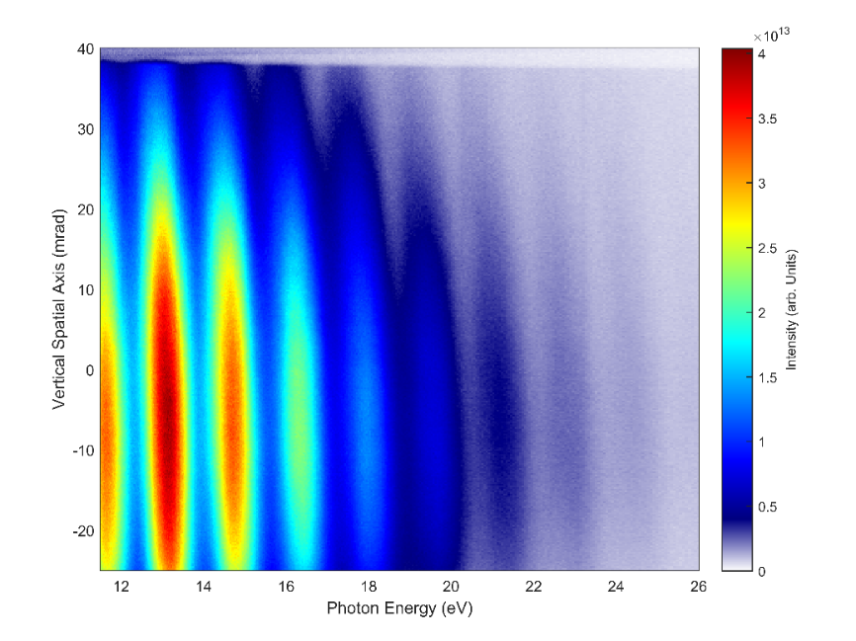
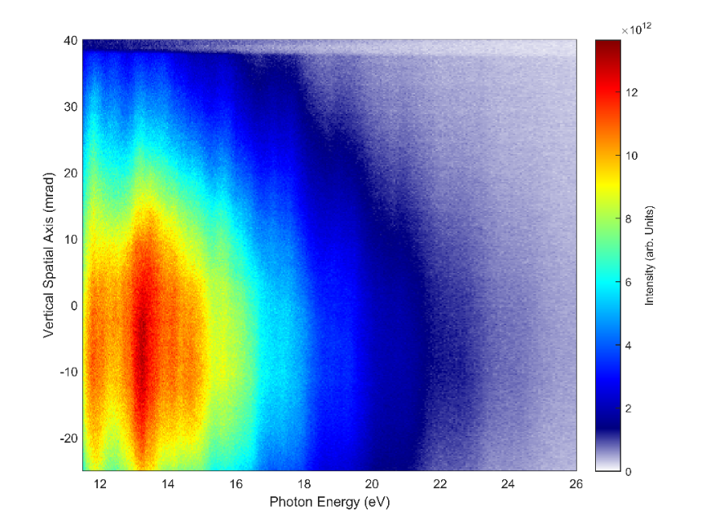
SHHG relativiste @ 1 kHz - Contrôle via CEP
3.5 fs ; a₀~ 2 / I = 1.10¹⁹ W/cm² ; Long gradient = 0.1λ ; CEP locked during one sequence
  PIC simulations by Maxence Thévenet :
IR (~ "sin" )
XUV
IR (~ "cos" )
XUV
in
out
in
out
t (fs)
t (fs)

Slide 17
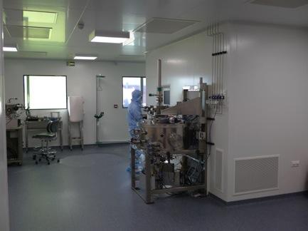
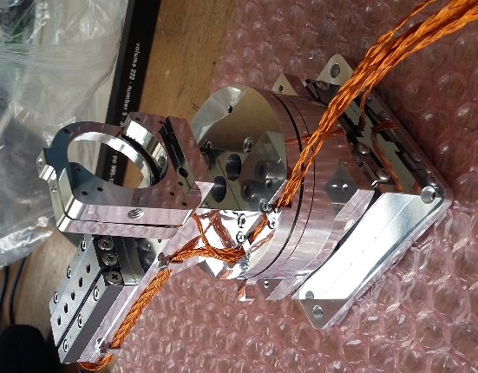
CeMOX : platform for X-ray optics
C. Bourassin-Bouchet, S. de Rossi, E. Meltchakov, F. Delmotte - OPT2X : M. Dehlinger
XUV multilayer mirrors : broadband & very broadband optics for SE10 beamline
Operational nov 2016
Cathodic magnetron sputtering
XUV
IR
Two-segment mirror – delay line

Slide 18
ANR – mid-term evaluation (June 2017)
Overall assessment and recommendations:
“ATTOLAB is a strong project that has the potential to generate innovative science.
The project is clearly well managed by a team of excellent researchers.
(…)
Overall, the project has well progressed and the team should be encouraged with some extra incentives.”

Slide 19
Access 2017-2019
type | access (%) | assessment
Laser R&D maintenance | 20% | Steering Committee
Consortium programs + collaborations | 60% | Steering Committee
National/European/international users | 20% | External (e.g., Laserlab)
LIDYL : external Acces
 | SE1 |  | SE10
 | Acces start | weeks/y | Access start | weeks/y
Laserlab | from oct 2017 | 3 | from dec 2018 | 3
National (Call LOA-CEA-CELIA) | 2018-T4 | 3 | 2018-T4 | 3
LOA : to be defined

Slide 20
SE1-SE10 program 2017-2018
 | SE1 | SE10
2017-T3 | LIDYL-Atto (A. Borot, P. Salières): Temporal structure of electronic wavepacket in resonant photoionization of atoms/molecules LIDYL-DYR (L. Poisson, B. Miranda) : dynamics in molecules : radicals - time-resolved PECD in chiral molecules
T4 |  | ISMO (D. Dowek) : Photoionization delay in molecules: studies in the molecular frame
2018-T1 |  | LPS (M. Marsi) : Dynamics in strongly correlated Mott-Hubbard materials transitions métal-isolant photo-induites dans Sr2IrO4
T2 | LIDYL-Atto (T. Ruchon) Highly nonlinear interactions of exotic fields with gases High harmonic generation with OAM vis-IR field (T. Ruchon) | LPMS (K. Hricovini) : BL commissioning Time- & spin-resolved electron dynamics in transition metal dichalcogenides (SrTiO3, GeTeMn)
T3 | LSI (S. Guizard) : Time-resolved absorption and electron relaxation in dielectrics (Al2O3)
T4 | External user | SPEC-LENSIS (N. Barrett) : PhotoEmission in multiferroics (X-PEEM MesoXcope) Etude de la structure de bande d’états excités dans BiFeO3
2019-T1 |  | External user
including 20% "Laser R&D and maintenance" time:
CEP stabilisation, sub20fs pulses, post-compression, tunability, tunability of the TiS amplifiers…

